Slide 1

VIRTUAL WALLET

Slide 2
BY
U. SRIRAM KOUSHIK
V. ASHOK KUMARESHEN
PSG COLLEGE OF TECHONOLOGY
PEELAMEDU, COIMBATORE

Slide 3
TAP TO PAY
VIRTUAL WALLET is the realization of the concept of easy money transaction using mobile phones based on NFC (Near Field Communication) Technology .
Through VIRTUAL WALLET an user is entitled to make cash transactions either by tapping the phone over a suitable tag device or bringing it in close proximity with the tag.
NFC enables data transmission within a range of only 4cm radius.

Slide 4
PROBLEMS / OPPORTUNITIES
A credit card can be misused by someone else other than the destined owner.
Large valued transactions cannot be carried out by mere cash.
Credit card transactions more prone to hacks.
Rs. 8.2 crore is lost annually in India due to credit card frauds.
Total amount of credit card fraud worldwide accounts for about 5.55 Billion annually.

Slide 5
PROPOSED VIRTUAL WALLET SYTEM
VIRTUAL WALLET system enables a user to transfer money through mobile phones using NFC technology.
It is as easy for the customer to just install an application, choose a method for payment and tap around to start making payments.
Introduce the idea of prepaid money transfer for the first time.

Slide 6
NFC ENABLED PHONE
PAYMENT GATEWAY
COMPUTER SYSTEM
AUTHENTICATION SYSTEM
VIRTUAL WALLET APPLICATION
TAP / OR CLOSER CONTACT
TRANSFER AMOUNT
NFC READER DEVICE
CREDIT /PREPAID CARD DETAILS STORAGE

Slide 7
SERVICE OFFERING
Virtual Kiosk
Virtual Pay (with direct link to bank account/credit card)
Virtual Pay(via virtual wallet account)

Slide 8
MARKET ANALYSIS
Virtual wallet mainly aims at working class people and students who own a mobile phone supporting NFC.
This system mainly aims at the Indian market where working class is now at their peak of rush and are in need for speed.
Another major market involves large institutions like IT companies, colleges look forward to incorporate cashless transaction.

Slide 9
Students fall in the target group since they would fantasise the fancy of tap and pay concept.
Any vendor who has a shop for himself and is ready to digitize their transaction system is a target. Large malls where the virtual kiosk could be implemented.
Roughly around 27,00,000 [Census India] people own a smart phone in India. Keeping aside the fact that an initial set of audience would resist change, 10,00,000 people would start using it in the first phase.

Slide 10
COMPETITOR ANALYSIS
As of now Google and Paypal provide a similar kind of service. But they are in their experimental stages.
Both these players have not introduced their services in the Indian market.
Virtual wallet thus intends to pitch into the Indian market and revolutionize the financial transaction sector.

Slide 11
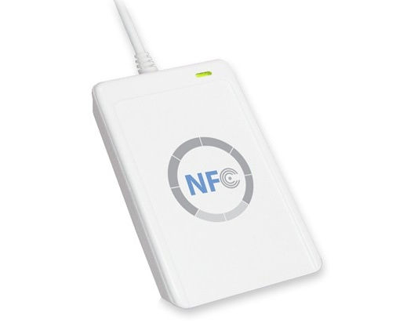
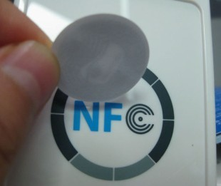
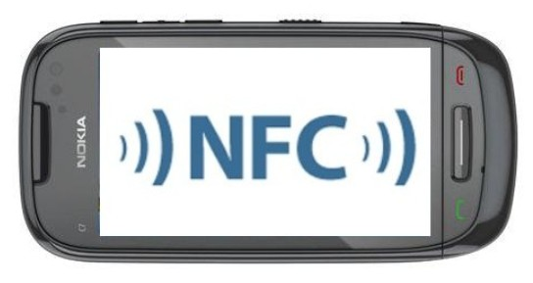
NFC reader
NFC sticker (tag)
A NFC enabled NOKIA phone

Slide 12
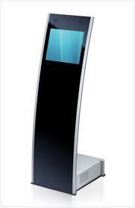
NFC based interactive model kiosk
ANIMATED DEMO

Slide 13
MARKET STRATEGY
Since we are the first of kind in this service in India, we would adopt a QCCB (quality cum cost based ) marketing strategy.
Our aim is to keep the customers out of chaos i.e. the customers should be clearly made aware of the plans that we offer and what the system is capable of in order to gain the trust of the initial customers.
For the first phase of the start up we concentrate on three plans

Slide 14
VENDORS FIRST
Instead of concentrating on the customers first, we plan upon concentrating on the vendors who are planning to incorporate a new automated system for their transactions.
Target vendors are usually medium sized shops or merchandises who will be eager to attract customers in a fascinating way.
The marketing team will always work on ideas of expanding the target vendor base.

Slide 15
EASY ACCESS
Advertising through the vendors.
Paste NFC stickers all around the vulnerable places like shops, malls where people could just tap their mobile phones on those stickers.
Doing so will install the app on their device and provide instructions about the app and the usage.

Slide 16
FASTER ACCESS
The system has to make the customer comfortable with this type of transaction.
To do this, the system facilitates various customer friendly options so as to locate vendors offering this service, discounts around the city etc.
The kiosks will provide an overall view of the services available in the mall.

Slide 17
OPERATION AND IMPLEMENTATION
The Virtual Wallet application is basically built on the mobile platforms of Android, IOS, Nokia Symbian.
The vendor side NFC reader device and kiosks are built keeping in mind the cost factor and the fact that the vendor is easily adjusted to the new system
The system would provide options for payment i.e. through their credit card account , bank account or the system also provides prepaid VW cards so that they could recharge their account whenever they wish.

Slide 18
The initial team would be divided into 7 different teams
Application developers team
Servers and related applications team
Direct vendor contact team
Process optimizing team
Financial Management team
Advertising team
Customer Support team

Slide 19
FINANCIAL ANALYSIS
The main cost encountered in this project can be attributed to the hardware development.
Hardware includes servers, vendor side NFC machines, NFC kiosks and tags.
Advertising cost includes the second major expenditure next to hardware development.
The details about the investment patterns, profits, shareholding information are discussed in the forthcoming slides.

Slide 20
INVESTMENT
virtual wallet.xlsx

Slide 21
SHARE HOLDING
virtual wallet.xlsx

Slide 22
PROFIT ANALYSIS
virtual wallet.xlsx

Slide 23
A profit is made out of every transaction that is being made.
A particular percentage of every transaction is being imposed on the customer as a service charge as follows
The maximum transaction value allowed per day is Rs.50,000 for security measures.
TRANSACTION VALUE | % SERVICE CHARGE
<=5000 | 2.5%
<=10000 | 2%
<=50000 | 1.5%

Slide 24
Since India has always worshipped smart phones and applications, it would be ideal enough to pitch in and it is the right time to get rid of the old, unsafe way of paying through credit cards and get into a fancy nature of the Virtual Wallet system. So it is already high time to
TAP AND PAY YOUR WAY !

Slide 25
THANK YOU

